Slide 2
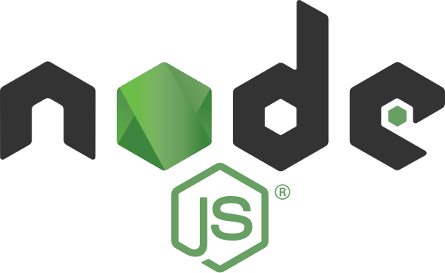
Introduction to Node.js
Exploring the Power Behind JavaScript on the Server

